Slide 1
THE
COMMONWEALTH
FUND
COMING OUT OF CRISIS:
PATIENT EXPERIENCES IN PRIMARY CARE IN
NEW ORLEANS, FOUR YEARS POST-KATRINA
Findings from The Commonwealth Fund
2009 Survey of Clinic Patients in New Orleans
January 2010

Slide 2
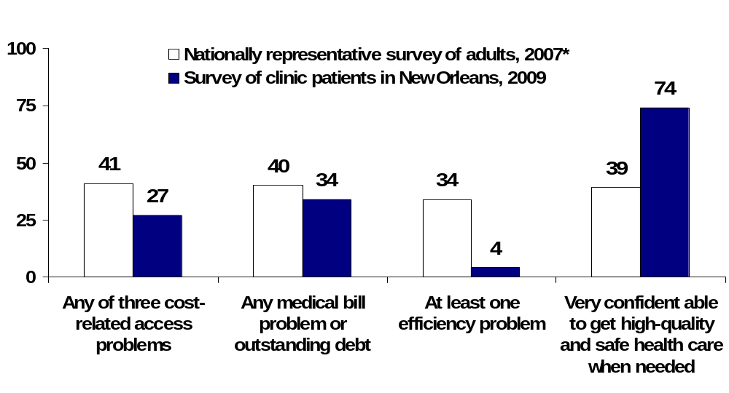
Exhibit ES-1. Fewer Clinic Patients Forgo Care Because of Cost,
Incur Accrued Medical Debt, or Experience Inefficiencies in Care: Confidence in Getting Care in The Future Is Very High
Percent of adults ages 18–64
Source: *The Commonwealth Fund Biennial Health Insurance Survey (2007), adults ages 19–64;
The Commonwealth Fund 2009 Survey of Clinic Patients in New Orleans, ages 18–64.

Slide 3
Exhibit ES-2. Indicators of Excellent Patient Experience
Among Clinic Patients in New Orleans
Indicators of excellent patient experience | Total Percent | Range of Clinic Mean Percent
Doctor or other health provider in this clinic understands important information about your medical history | 98 | 97–100
Easy or very easy to access medical advice via telephone during regular practice hours, or get after-hours care, or could make a same day or next day appointment | 88 | 71–100
Care transitions are coordinated by a clinician in this clinic¹ | 52 | 18–94
Patient-clinician communications are excellent² | 79 | 63–100
Has all indicators of excellent patient experience | 37 | 10–78
¹ Coordinated care defined as “yes” to one or more of: 1) someone at clinic helped coordinate or arrange care received from other doctors or places, 2) the doctors in this clinic helped you decide which specialist to see, 3) after you saw this other doctor or specialist, the doctors in this clinic helped you understand or make decisions about the information or care you received from the other doctor.
² Excellent patient-clinician communications defined as “always” to all of the following: how often did a clinician in this clinic
1) listen carefully to you, 2) explain things in a way you can understand, 3) spend enough time with you, 4) involve you in decisions about the best treatment option for you; and “never” to: 5) did you ever leave with important questions about your treatment unanswered?
Source: The Commonwealth Fund 2009 Survey of Clinic Patients in New Orleans.

Slide 4
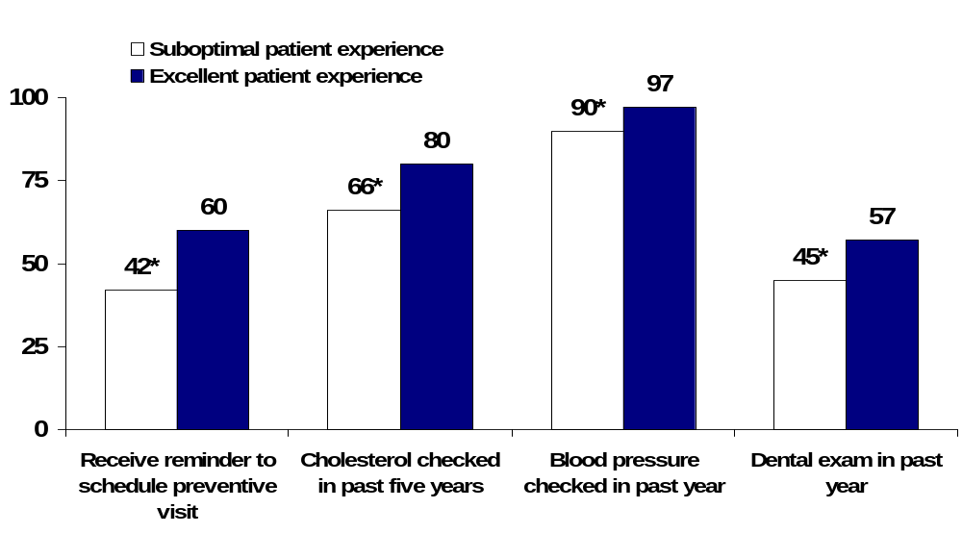
Exhibit ES-3. A Majority of Adults with an Excellent Patient Experience Receive Reminders for and Utilize Preventive Care
Percent of adults 18–64
Note: Excellent patient experience includes providers understanding medical history, has easy
access to care, care is coordinated by clinic, and has excellent patient-provider communications.
*Indicates significant difference compared with Excellent Patient Experience (p<.05).
Source: The Commonwealth Fund 2009 Survey of Clinic Patients in New Orleans.

Slide 5
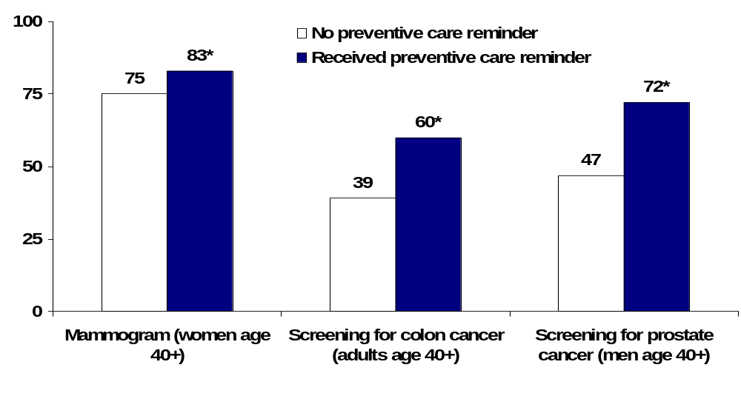
Exhibit ES-4. Preventive Care Reminders Make a Significant Difference in Whether or Not Patients Receive Recommended Cancer Screenings
Percent of adults ages 18–64 receiving cancer screenings
*Indicates significant difference compared with “No preventive care reminder” (p<.05).
Source: The Commonwealth Fund 2009 Survey of Clinic Patients in New Orleans.

Slide 6
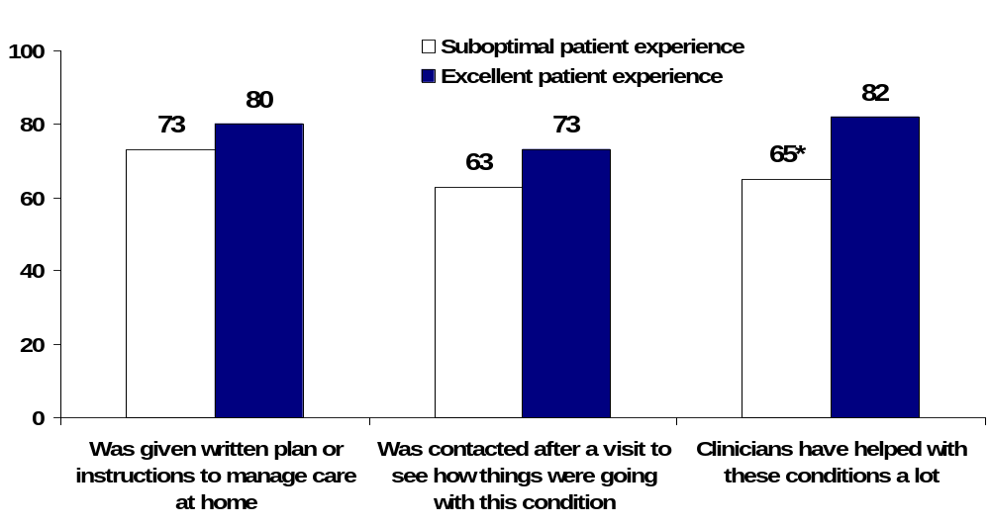
Exhibit ES-5. Adults with Health Problems Who Have an Excellent Patient Experience Report Greater Support to Help Manage Their Health Condition
Percent of adults 18–64 with one or more chronic conditions
reporting case management activities
Note: Excellent patient experience includes providers understanding medical history, has easy
access to care, care is coordinated by clinic, and has excellent patient-provider communications.
*Indicates significant difference compared with Excellent Patient Experience (p<.05).
Source: The Commonwealth Fund 2009 Survey of Clinic Patients in New Orleans.

Slide 7
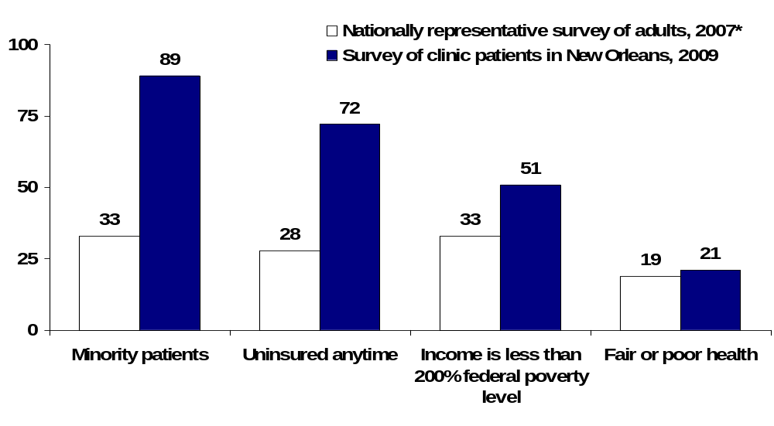
Exhibit 1. Clinics in New Orleans Are Serving a Particularly Vulnerable Population Compared with National Estimates—
The Vast Majority Are Uninsured, Low Income, and Minority
Percent of adults ages 18–64
Source: *The Commonwealth Fund Biennial Health Insurance Survey (2007), adults ages 19–64;
The Commonwealth Fund 2009 Survey of Clinic Patients in New Orleans, ages 18–64.

Slide 8
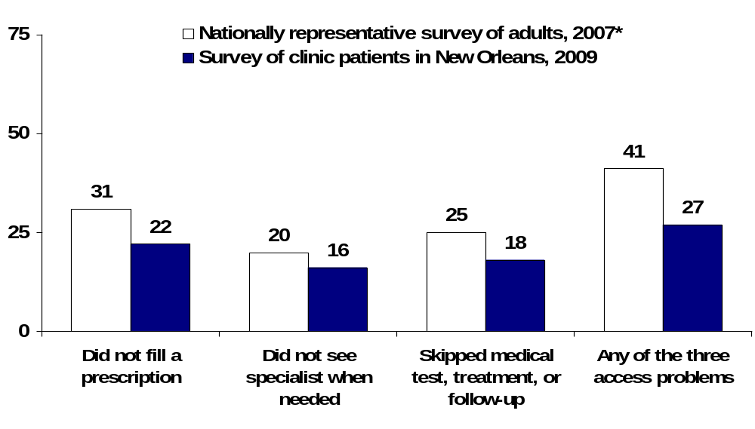
Exhibit 2. Fewer Clinic Patients Have Problems Accessing
Needed Medical Care Than Adults Across the Country
Percent of adults ages 18–64
Source: *The Commonwealth Fund Biennial Health Insurance Survey (2007), adults ages 19–64;
The Commonwealth Fund 2009 Survey of Clinic Patients in New Orleans, ages 18–64.

Slide 9
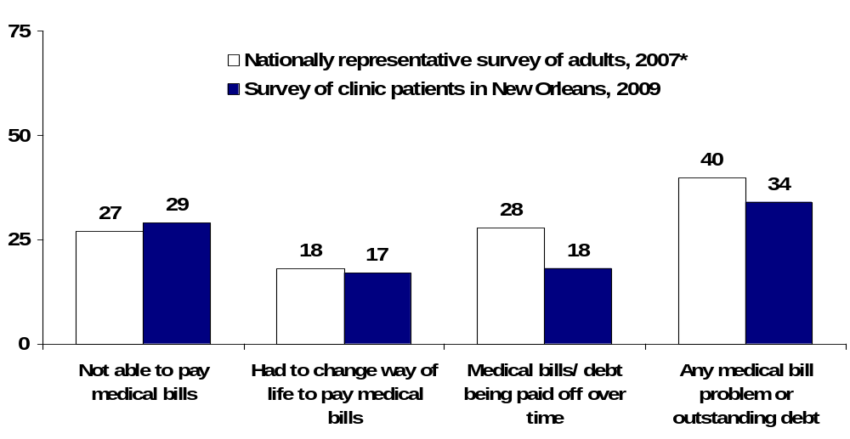
Exhibit 3. Clinic Patients Have Lower Rates of Accumulated
Medical Debt Than Adults Across the Country
Percent of adults ages 18–64
Source: *The Commonwealth Fund Biennial Health Insurance Survey (2007), adults ages 19–64;
The Commonwealth Fund 2009 Survey of Clinic Patients in New Orleans, ages 18–64.

Slide 10
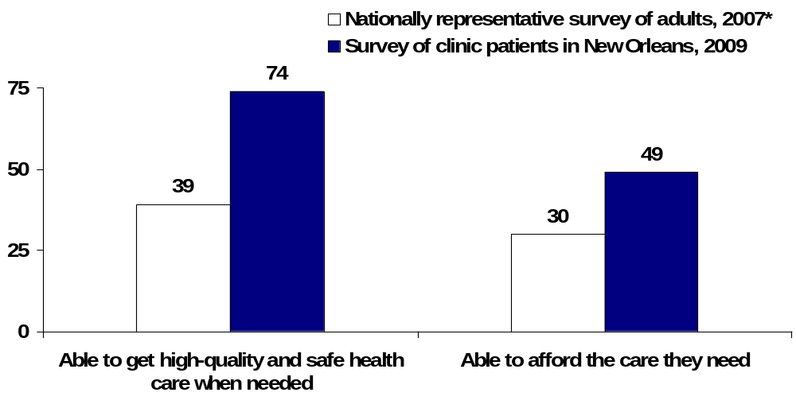
Exhibit 4. Clinic Patients Have Greater Confidence in Their Ability to
Get and Afford High-Quality Health Care Than Adults Across the Country
Percent of adults ages 18–64 who are very confident that they will be:
Source: *The Commonwealth Fund Biennial Health Insurance Survey (2007), adults ages 19–64;
The Commonwealth Fund 2009 Survey of Clinic Patients in New Orleans, ages 18–64.

Slide 11
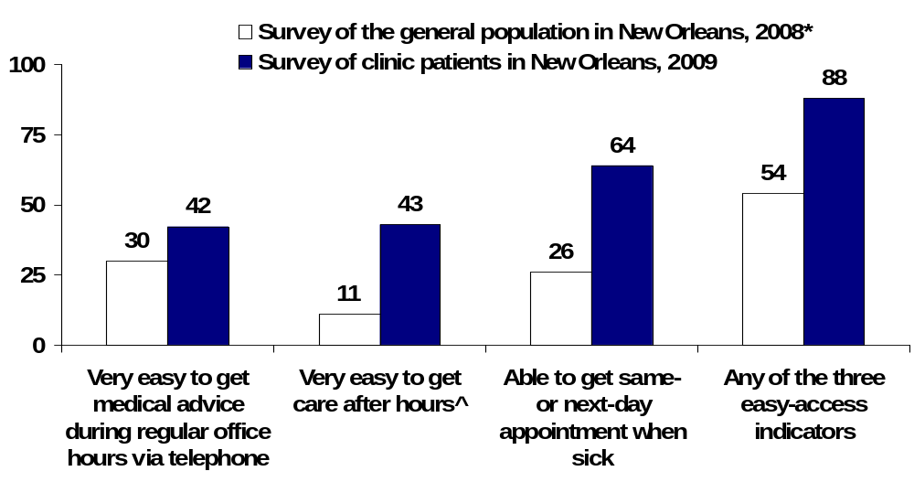
Exhibit 5. Clinic Patients Have Greater Accessibility to Same- or Next-Day Medical Appointments and After-Hours Care Than the General Population in New Orleans
Percent of adults ages 18–64
^After hours includes during the evenings, on the weekends, or on holidays.
Source: *New Orleans Three Years After the Storm: The Second Kaiser Post-Katrina Survey (2008);
The Commonwealth Fund 2009 Survey of Clinic Patients in New Orleans.

Slide 12
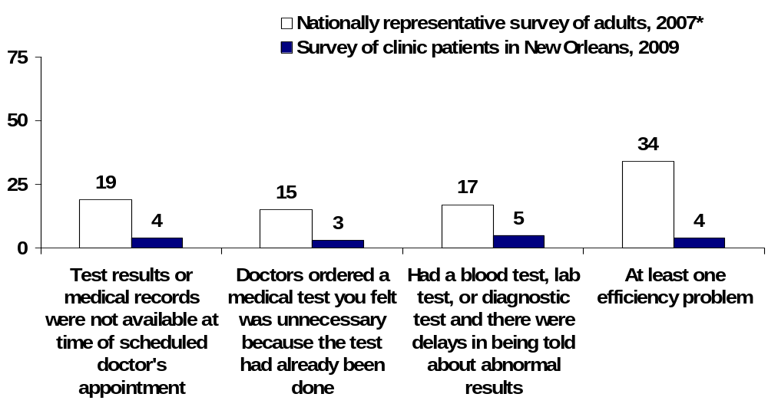
Exhibit 6. Replicated Tests, Delays in Receiving Tests Results, and Other Inefficiencies Are Less Common Among Clinic Patients
Percent of adults ages 18–64
Source: *The Commonwealth Fund Biennial Health Insurance Survey (2007), adults ages 19–64;
The Commonwealth Fund 2009 Survey of Clinic Patients in New Orleans, ages 18–64.

Slide 13
Exhibit 7. Indicators of Excellent Patient Experience
Among Clinic Patients in New Orleans
Indicators of excellent patient experience | Total Percent | Range of Clinic Mean Percent
Doctor or other health provider in this clinic understands important information about your medical history | 98 | 97–100
Easy or very easy to access medical advice via telephone during regular practice hours, or get after-hours care, or could make a same day or next day appointment | 88 | 71–100
Care transitions are coordinated by a clinician in this clinic¹ | 52 | 18–94
Patient-clinician communications are excellent² | 79 | 63–100
Has all indicators of excellent patient experience | 37 | 10–78
¹ Coordinated care defined as “yes” to one or more of: 1) someone at clinic helped coordinate or arrange care received from other doctors or places, 2) the doctors in this clinic helped you decide which specialist to see, 3) after you saw this other doctor or specialist, the doctors in this clinic helped you understand or make decisions about the information or care you received from the other doctor.
² Excellent patient-clinician communications defined as “always” to all of the following: how often did a clinician in this clinic
1) listen carefully to you, 2) explain things in a way you can understand, 3) spend enough time with you, 4) involve you in decisions about the best treatment option for you; and “never” to: 5) did you ever leave with important questions about your treatment unanswered?
Source: The Commonwealth Fund 2009 Survey of Clinic Patients in New Orleans.

Slide 14

Exhibit 8. A Majority of Adults with an Excellent Patient Experience Receive Reminders for and Utilize Preventive Care
Percent of adults 18–64
Note: Excellent patient experience includes providers understanding medical history, has easy
access to care, care is coordinated by clinic, and has excellent patient-provider communications.
*Indicates significant difference compared with Excellent Patient Experience (p<.05).
Source: The Commonwealth Fund 2009 Survey of Clinic Patients in New Orleans.

Slide 15
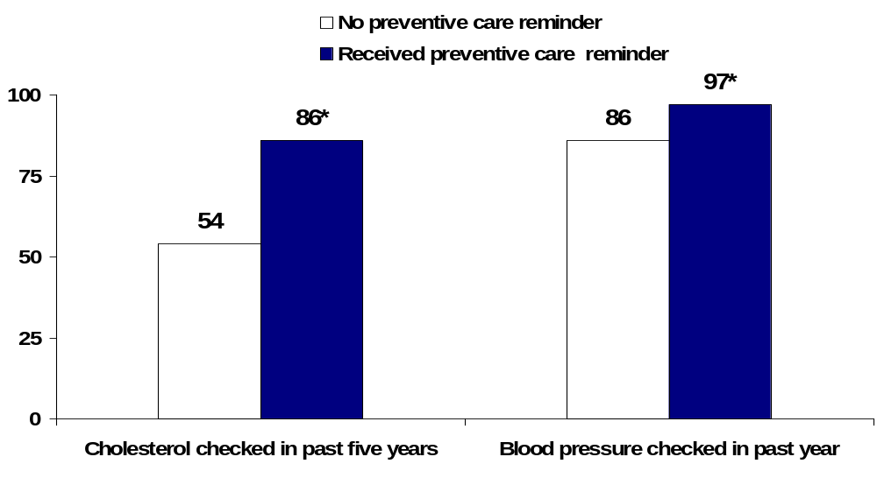
Exhibit 9. Adults Who Receive Preventive Care Reminders
Are More Likely to Get Preventive Care Services
Percent of adults 18–64 receiving preventive services in this clinic
*Indicates significant difference compared with “No preventive care reminder” (p<.05).
Source: The Commonwealth Fund 2009 Survey of Clinic Patients in New Orleans.

Slide 16
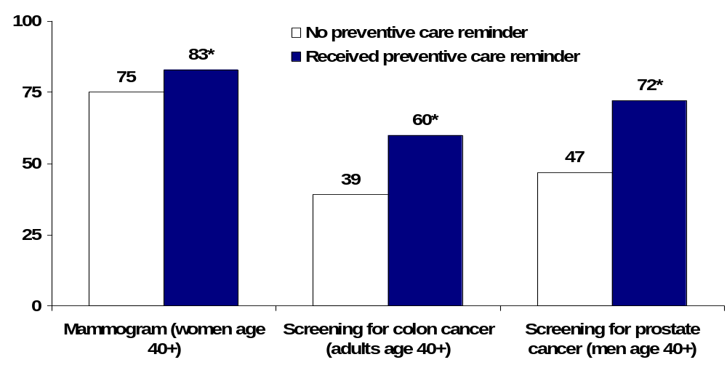
Exhibit 10. Preventive Care Reminders Make a Significant Difference in Whether or Not Patients Receive Recommended Cancer Screenings
Percent of adults ages 18–64 receiving cancer screenings
*Indicates significant difference compared with “No preventive care reminder” (p<.05).
Source: The Commonwealth Fund 2009 Survey of Clinic Patients in New Orleans.

Slide 17
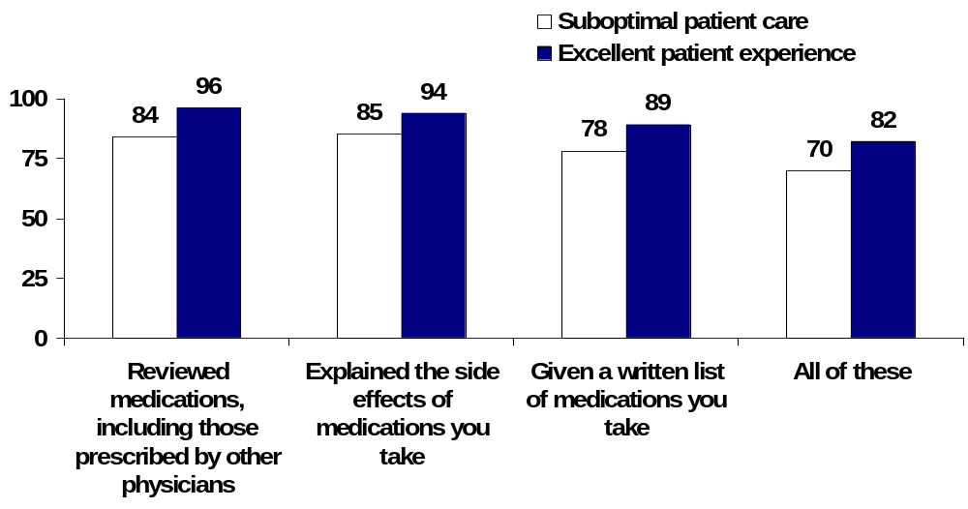
Exhibit 11. Adults with Health Problems Who Have an Excellent Patient Experience Are Most Likely to Be Well-Informed About Their Prescription Medications
Percent of adults ages 18–64 with one or more chronic conditions reporting clinicians have:
*
*
*
Note: Excellent patient experience includes providers understanding medical history, has easy
access to care, care is coordinated by clinic, and has excellent patient–provider communications.
*Indicates significant difference compared with Excellent Patient Experience (p<.05).
Source: The Commonwealth Fund 2009 Survey of Clinic Patients in New Orleans.

Slide 18
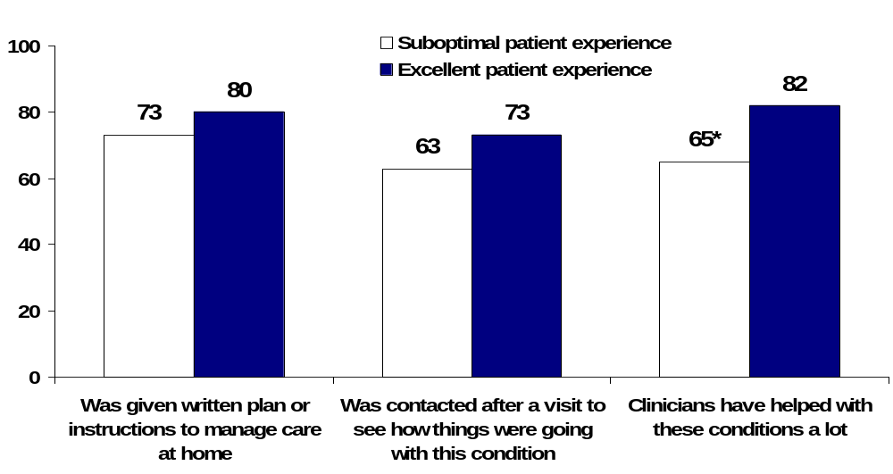
Exhibit 12. Adults with Health Problems Who Have an Excellent Patient Experience Report Greater Support to Help Manage Their Health Condition
Percent of adults 18–64 with one or more chronic conditions
reporting case management activities
Note: Excellent patient experience includes providers understanding medical history, has easy
access to care, care is coordinated by clinic, and has excellent patient-provider communications.
*Indicates significant difference compared with Excellent Patient Experience (p<.05).
Source: The Commonwealth Fund 2009 Survey of Clinic Patients in New Orleans.

Slide 19
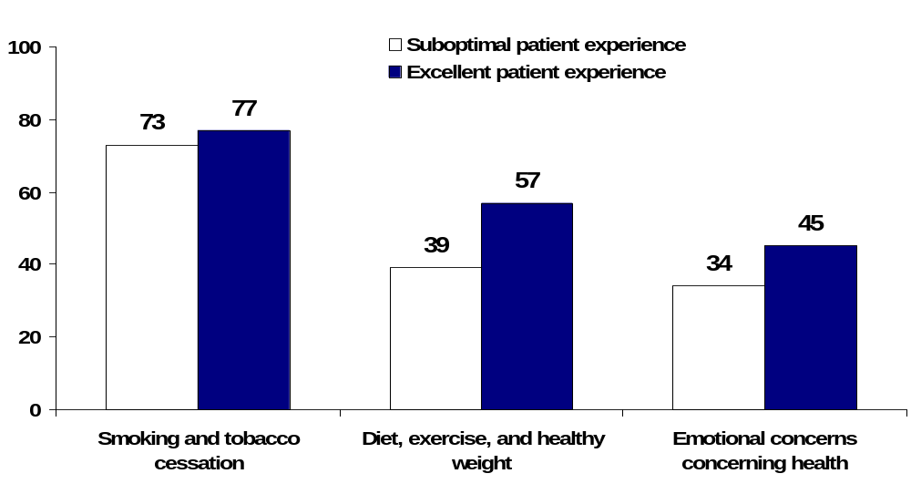
Exhibit 13. Adults with an Excellent Patient Experience
Are More Likely to Receive Counseling About Healthy Behaviors
Percent of adults 18–64 reporting counseling by a doctor or medical professional in this clinic
*
*
Note: Excellent patient experience includes providers understanding medical history, has easy
access to care, care is coordinated by clinic, and has excellent patient-provider communications.
*Indicates significant difference compared with Excellent Patient Experience (p<.05).
Source: The Commonwealth Fund 2009 Survey of Clinic Patients in New Orleans.

Slide 20
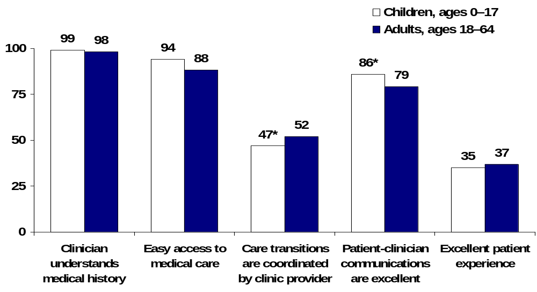
Exhibit 14. Indicators of Excellent Patient Experience:
Child and Adult Patients Have Similar Care Experiences
Percent of respondents
Note: Excellent patient experience includes all other measures displayed here.
*Indicates significant difference compared with adults (p<.05).
Source: The Commonwealth Fund 2009 Survey of Clinic Patients in New Orleans.

Slide 21
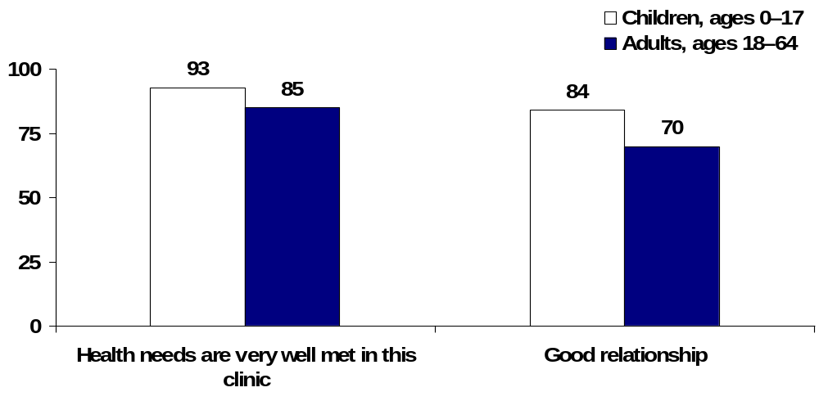
Exhibit 15. The Vast Majority of Pediatric Patients
Are Very Satisfied with Their Quality of Care
Percent of respondents
*
Note: Good relationship with clinician includes trusting the clinician, clinician shows respect for what
patient has to say, and patient is never treated unfairly or with disrespect due to ability to pay, type of
insurance, English fluency, or race/ethnic background.
*Indicates significant difference compared with adults (p<.05).
Source: The Commonwealth Fund 2009 Survey of Clinic Patients in New Orleans.

